Slide 1

Lecture 11: IT Challenges
Hoger Mahmud

Slide 2



Lecture outline
The challenge area of IT
- trust issue
- ethic issue
- social issue
-economical issue
- quality of life issue
2

Slide 3
IT challenge areas
Challenge: by challenges we mean the problems that we need to solve and the areas we need to discuss and improve.
IT Challenges
faith issues
Trust issues
Security issues
Quality of life issues
Economic issues
Ethics issues
Social issues
3

Slide 4
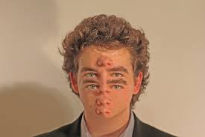
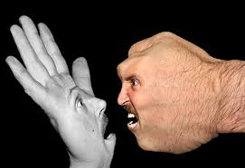
Trust Issue: Manipulating digital data
Example: digital sound and images can be manipulated
Has made photographs and recordings untrustworthy
“News” can be faked
4

Slide 5
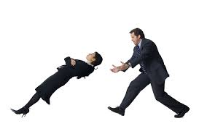
Trust Issue: Manipulating digital data
Example2:Limitations of public databases: accuracy and completeness
You can’t get the whole story
The data is not necessarily accurate
Each database service has boundaries
Different keywords bring different results
5

Slide 6

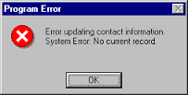

Security Issues: Threats to Computers & Communications Systems
Errors and Accidents
Human errors
Human emotions affect performance
Procedural errors
When people fail to follow established procedures, errors can occur
Software errors
Software bug: an error in a program that causes it not to work properly
“Dirty data” problems
Incomplete, outdated, or otherwise inaccurate data
6

Slide 7

Ethics Issues
Computer Crimes
Two types of computer crime:
Illegal act carried out against computers
or telecommunication systems
Use of computers or telecommunications
to accomplish an illegal act
Knowledge theft: stealing and using others ideas and works
Identity theft: stealing and using others identity
Operational attacks: using viruses and other attacks to disable operations
7

Slide 8
Quality of life issue
Environmental Problems
Manufacturing computers and circuits can cause pollution
Hazardous toxins are involved in computer manufacture
Wireless devices can interfere in hospital activities and with medical devices
Mental-Health Problems
Isolation: computer gamers may substitute online games for interpersonal interaction
Online gambling is too easy
Many users find computers stressful and anger-inducing
Online Sexual Predators
Cyberbullies: attacking and bulling people on line
Other addictions e.g. facebook addiction
8

Slide 9
Economic and political issues
Technology may affect the gap between the rich and the poor (“digital divide”)
Most jobs require employees who are tech-savvy
Technology is being used to replace employees in traditional jobs, traditionally filled by untrained workers
Political issues: Many governments censor internet content available in their countries
9

Slide 10
The need for spirituality in digital age
Spiritual practices that foster the mind’s development
Silence
Letting go of our inner distractions
Solitude
Letting go of our outer distractions
Surrender
To receive God’s best for your life
10

Slide 11

Thank you
?

